Slide 1
Modules
Why Module | Module Exports | Module Imports
Notes:
Welcome to our lecture on Modules. In this lecture we will go why to use modules, how to export and import modules in your web project. Let’s start the video lecture.

Slide 2

Why Module
Organization: Groups related functionality for better code structure.
Reusability: Exported variables, functions, or classes can be reused across modules.
Maintainability: Easier to manage and update code in separate, organized files.
Notes:
Now, let's explore why modules are essential in Node.js. Modules help with organization by grouping related functionality, making the code structure clearer. They enhance reusability by allowing exported variables, functions, and classes to be used across different parts of the application. This also improves maintainability, as separate files are easier to manage and update.

Slide 3
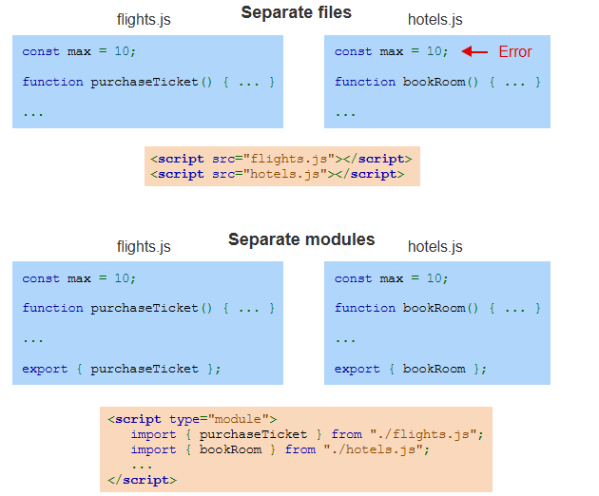
Example
Notes:
Here’s an example illustrating the difference between separate files and separate modules. In the "Separate files" example, the script tags reference external files but cause an error because the code isn't modular. In the "Separate modules" example, the flight and hotel modules export functions, and they are imported using the module system, ensuring no errors and allowing proper reuse.

Slide 4
Module Exports
Multiple Exports: Use braces (e.g., export { item1, item2 }) or before each declaration.
Single Export: Use export default (e.g., export default item).
Default Declaration: Can be used directly before the function or class.
Notes:
Now, let's talk about module exports. For multiple exports, use braces like export { item1, item2 } or place export before each declaration. For a single export, use export default, like export default item. The default declaration can be placed directly before the function or class you want to export, making it simpler to export one main item from a module.

Slide 5
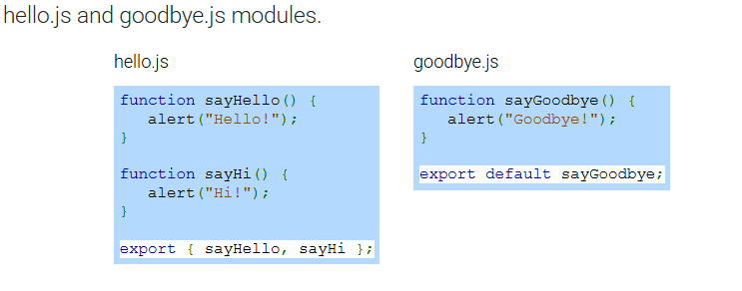
Example
Notes:
Here is an example with two modules, hello.js and goodbye.js. In hello.js, two functions, say Hello and say Hi, are defined and exported together using export say Hello, say Hi . In goodbye.js, the function say Good bye is defined and exported as the default export using export default say Good bye. This shows how to export both multiple and single items from modules.

Slide 6
Module Import
Non-default Imports: Use braces (e.g., import { item1, item2 } from "./my_module.js";).
Default Imports: No braces needed (e.g., import defaultItem from "./my_module.js";).
Script Type: Use <script type="module"> for imports in HTML.
File Location: Modules must be on a web server; file:// protocol doesn't support imports.
Notes:
Now, let's cover module imports. For non-default imports, use braces like import item1, item2 within braces from my module.js. For default imports, no braces are needed, e.g., import default Item from my module.js. In HTML, use script tag with type module to enable module imports. Note that modules must be hosted on a web server, as the file protocol doesn't support imports.

Slide 7
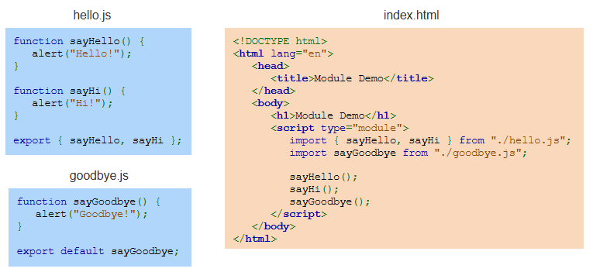
Example
Notes:
Here's an example of module imports in action. In the hello.js file, we export two functions, say Hello and say Hi. In the goodbye.js file, we export the say Goodbye function as the default export. In index.html, we import these functions using script tag with type module. Then, we call the imported functions in the body to display the alerts. Thanks for watching the lecture.

